Slide 1

Integration Area Programme Evaluation
Evgeniya Gorbatsevich
March 2023

Slide 2
Background

Slide 3
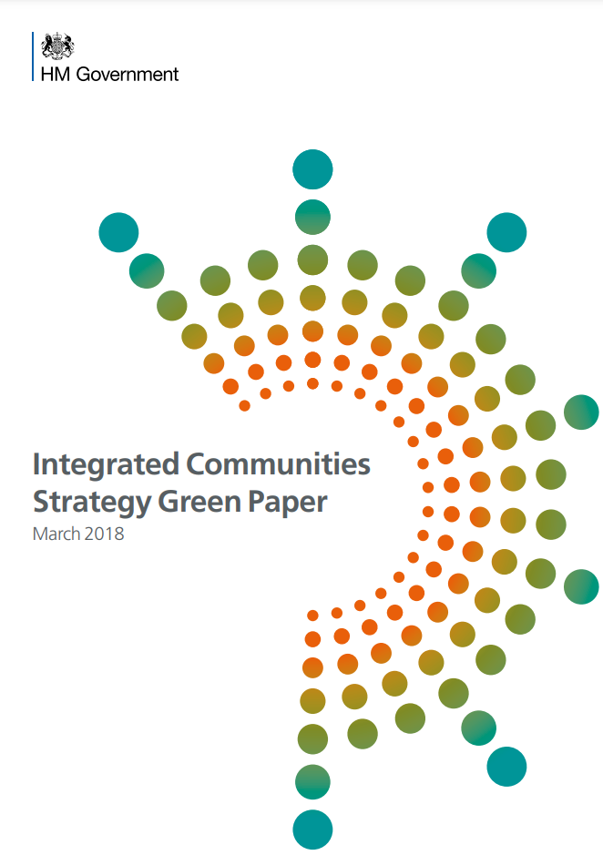
Integration Area Programme
The IAP was borne out of the Integrated Communities Strategy green paper, published in March 2018
…trialling a new place-based approach to social integration in five local authorities
With the aim of “building strong integrated communities where people – whatever their background – live, work, learn and socialise together, based on shared rights, responsibilities, and opportunities.”

Slide 4


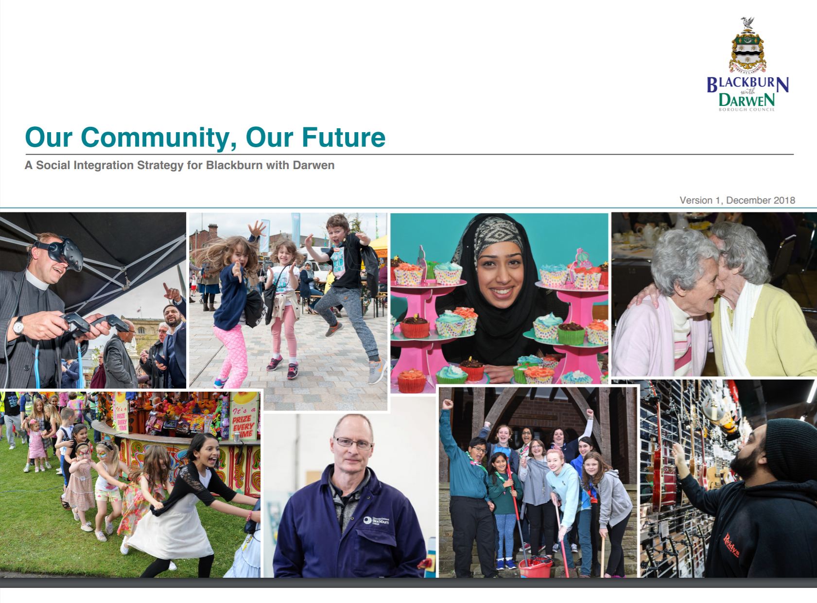


Each area produced a locally-focussed integration strategy, outlining the activity they will do to create stronger, more integrated, communities in their local area.
IFF Research were commissioned to carry out a national evaluation that took into account local variation
Notes:
5 pilot areas:
Blackburn with Darwen
Bradford
Peterborough
Walsall
Waltham Forest

Slide 5

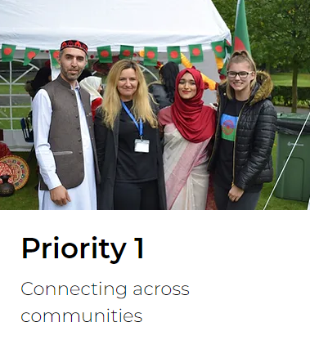
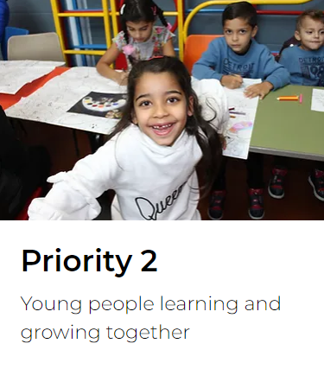
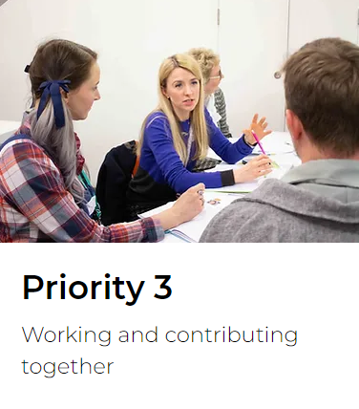
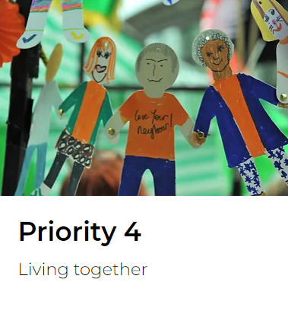
“Our vision is to create integrated, empowered and inclusive communities where people from all backgrounds come together to celebrate what they have in common”
Notes:
“Our vision is to create integrated, empowered and inclusive communities where people from all backgrounds come together to celebrate what they have in common: a place where our residents feel safe and valued, and where everyone has fair opportunities to fulfil their potential and contribute to the growth of Walsall.”
…activities intended to create long-term positive changes in and among communities across the borough”

Slide 6


By March 2020 IAP delivered…
The IAP involved
5
pilot areas
Blackburn with Darwen
Bradford
Peterborough
Walsall
Waltham Forest
92
organisations
were reported to have been engaged by IAP funded projects.
This includes social/private and public sector organisations
68
projects
were funded by the Integration Area Programme
Over £10 million
available to spend on the programme
13,326
people
were reported to have been engaged across IAP funded projects*
625
events/sessions/ workshops
were reported to have been delivered
through IAP funded projects
*This includes attendees at events in the community and in schools, participants in a variety of training programmes, community volunteers and mentors, and individuals in receipt of support such as through Welcome Packs and Job Centre Plus initiatives.

Slide 7
Evaluation

Slide 8







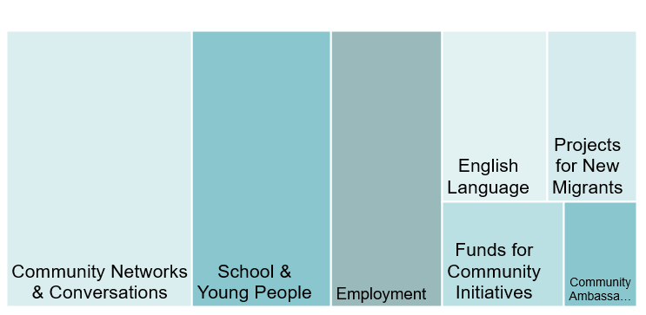
Activities in the Integration Areas fell into 7 main themes
Within these themes there were
3
project types
that were common across local areas
Community Ambassadors: aim to develop local leadership to support community integration.
Community Conversations: aim to bring together local people from different backgrounds in a safe space to engage in facilitated debate on topics such as race, culture and religion.
Schools Linking: aims to link pupils from different local schools to meet and mix

Slide 9
Measuring success
Measuring success
Evaluation aims
Measure the profile of locally delivered events or activities and their participants
Measure outcomes of local intervention approaches
Learn lessons about factors influencing local delivery
Increased levels of meaningful social mixing between communities
Feeling more at ease with people from different backgrounds
Improved feeling that differences between people are respected
Improved feeling that people from different backgrounds get along well in the local area
Example programme outcomes
How strongly do you feel you belong to the local area?
How comfortable do you feel talking to people from different backgrounds to you (more than just saying hello)?
To what extent do you agree or disagree that residents in this local area respect differences between other people in the area?

Slide 10
Evaluation approach
PRE PANDEMIC
Counter-factual survey
Counter-factual survey
Counter-factual survey
*MI = management information – this includes data collected by projects about their activities, like participant demographics, the number of people attending an event or the number of events held

Slide 11
Evaluation approach
Pandemic led to changes to the pure impact approach of the evaluation
POST PANDEMIC
Counter-factual survey
Counter-factual survey
Interviews with project delivery stakeholders
*MI = management information – this includes data collected by projects about their activities, like participant demographics, the number of people attending an event or the number of events held

Slide 12
Key findings

Slide 13
Community Conversations
Measuring success
Events that created safe spaces for community members to engage in facilitated debate on integration-related topics such as race, culture, and religion.
Walsall’s Community Dialogue
“…to capture the voices, stories and experiences of those living in Walsall around the themes of identity, diversity, belonging and living together. The project enables new people to create connections with each other”
10 local community groups come together for three online sessions.
Partnered different community groups to build trust between these groups, and to facilitate open and honest conversations
Evaluation in Walsall, Bradford, and Blackburn with Darwen

Slide 14
Community Conversations
Measuring success
Impact:
Well received by participants, who found their experience positive, and felt a sense of pride and satisfaction from being involved.
It may have had an influence over some of the outcome areas of meaningful social mixing and around increased motivation to create change in the community.
However, pandemic and intervention size-related evaluation limitations mean that it is not possible to say with certainty whether the Community Conversations intervention worked to achieve its intended outcomes.
Delivery:
Delivery partners should aim for events to have a mix, or equal representations, of community groups.
Following up with participants, or planning additional touch-points after the conversations events have finished, would help ensure momentum to continue community discussion and mixing is maintained.
“…Foundation areas towards empowerment and influence”

Slide 15



Community Ambassadors
Training and support to local volunteers with the aim of developing local leadership skills for championing of integration values within their communities
Blackburn with Darwen
developing local community leaders to support community integration by designing and running social action projects.
improve social mixing in the area which was in turn intended to help break down barriers, build resilience and confidence within the community.
Bradford
took an Asset Based Community Development (ABCD) approach – assessing the resources, skills, and experience available in the community to organise and inspire the community into action
Peterborough

Slide 16
Community Ambassadors
Impacts
Several positive impacts, for example in improving Ambassadors’ comfort engaging with individuals from different backgrounds and their motivation to effect local improvements.
Ambassadors have gained a better awareness and understanding of other cultures, been inspired to become more involved in community action, and become more empowered to drive change.
Delivery
Different recruitment strategies led to differences in diversity across Ambassador groups. More diversity was felt to be beneficial.
A combination of increased exposure to community activities/ events, and the support of their fellow Ambassadors, inspired Ambassadors to become more involved in community action.
Training resulted in Ambassadors feeling empowered to drive positive change in their communities.
Programme impacts
Several positive impacts, for example in improving Ambassadors’ comfort engaging with individuals from different backgrounds and their motivation to effect local improvements.
Ambassadors have gained a better awareness and understanding of other cultures, been inspired to become more involved in community action, and become more empowered to drive change.
However, more evidence is needed to see how trained Ambassadors go on to impact their local communities

Slide 17
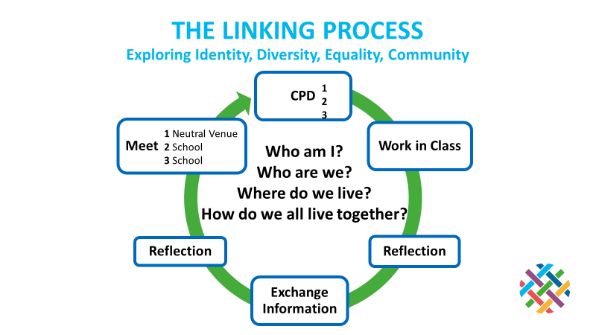
Schools Linking
Measuring success
Aims to promote social cohesion by facilitating social mixing between pupils in schools within areas that have been identified as places with segregated communities

Slide 18
Schools Linking
Measuring success
Findings suggest that even a limited programme of Schools Linking activities, carried out online, has a positive effect on pupils and helped to support IAP related outcomes in participating schools
Some significantly higher ratings by the end of the Linking programme compared to the baseline:
    How confident teachers felt their pupils were in mixing with people from different backgrounds, particularly pupils from a different religion (which increased from 52% to 72%)
    The extent to which teachers felt their pupils are aware of similarities between themselves
    and others from different backgrounds to them, increasing from 23% to 72%.
Qualitative interviews: Schools Linking contributed to pupils becoming more confident with interacting with other young people of different ethnicities, religions and economic backgrounds.
However: less positive outcomes
than teachers in comparison schools,
e.g. in terms of confidence
in social mixing.
This suggests SL is being targeted at schools where there is greater need for this type of intervention.
However it is difficult to draw firm conclusions on this, and the reasons behind this should be explored in more detail in future.

Slide 19





Lessons learned from across IAP
Programmes like IAP help to remove some of the barriers which prevent communities from mixing in a cohesive and mutually agreeable way
Cohesion is not necessarily achieved with one-off interventions, but requires continuous engagement, including from different angles, and depending on the local context.
Programmes need to adapt to local circumstances, pressures, and inter-community dynamics. The lessons from these projects show what can be achieved up to a point in time, while funding and policy resource is available.
Other research (e.g. the Belong report: Beyond Us and Them) suggests leadership and a local cohesion strategy for an area can be key in driving social cohesion and resilience.
Evaluation can be key to learning what works to support social cohesion, as well as how it works.

